Slide 1
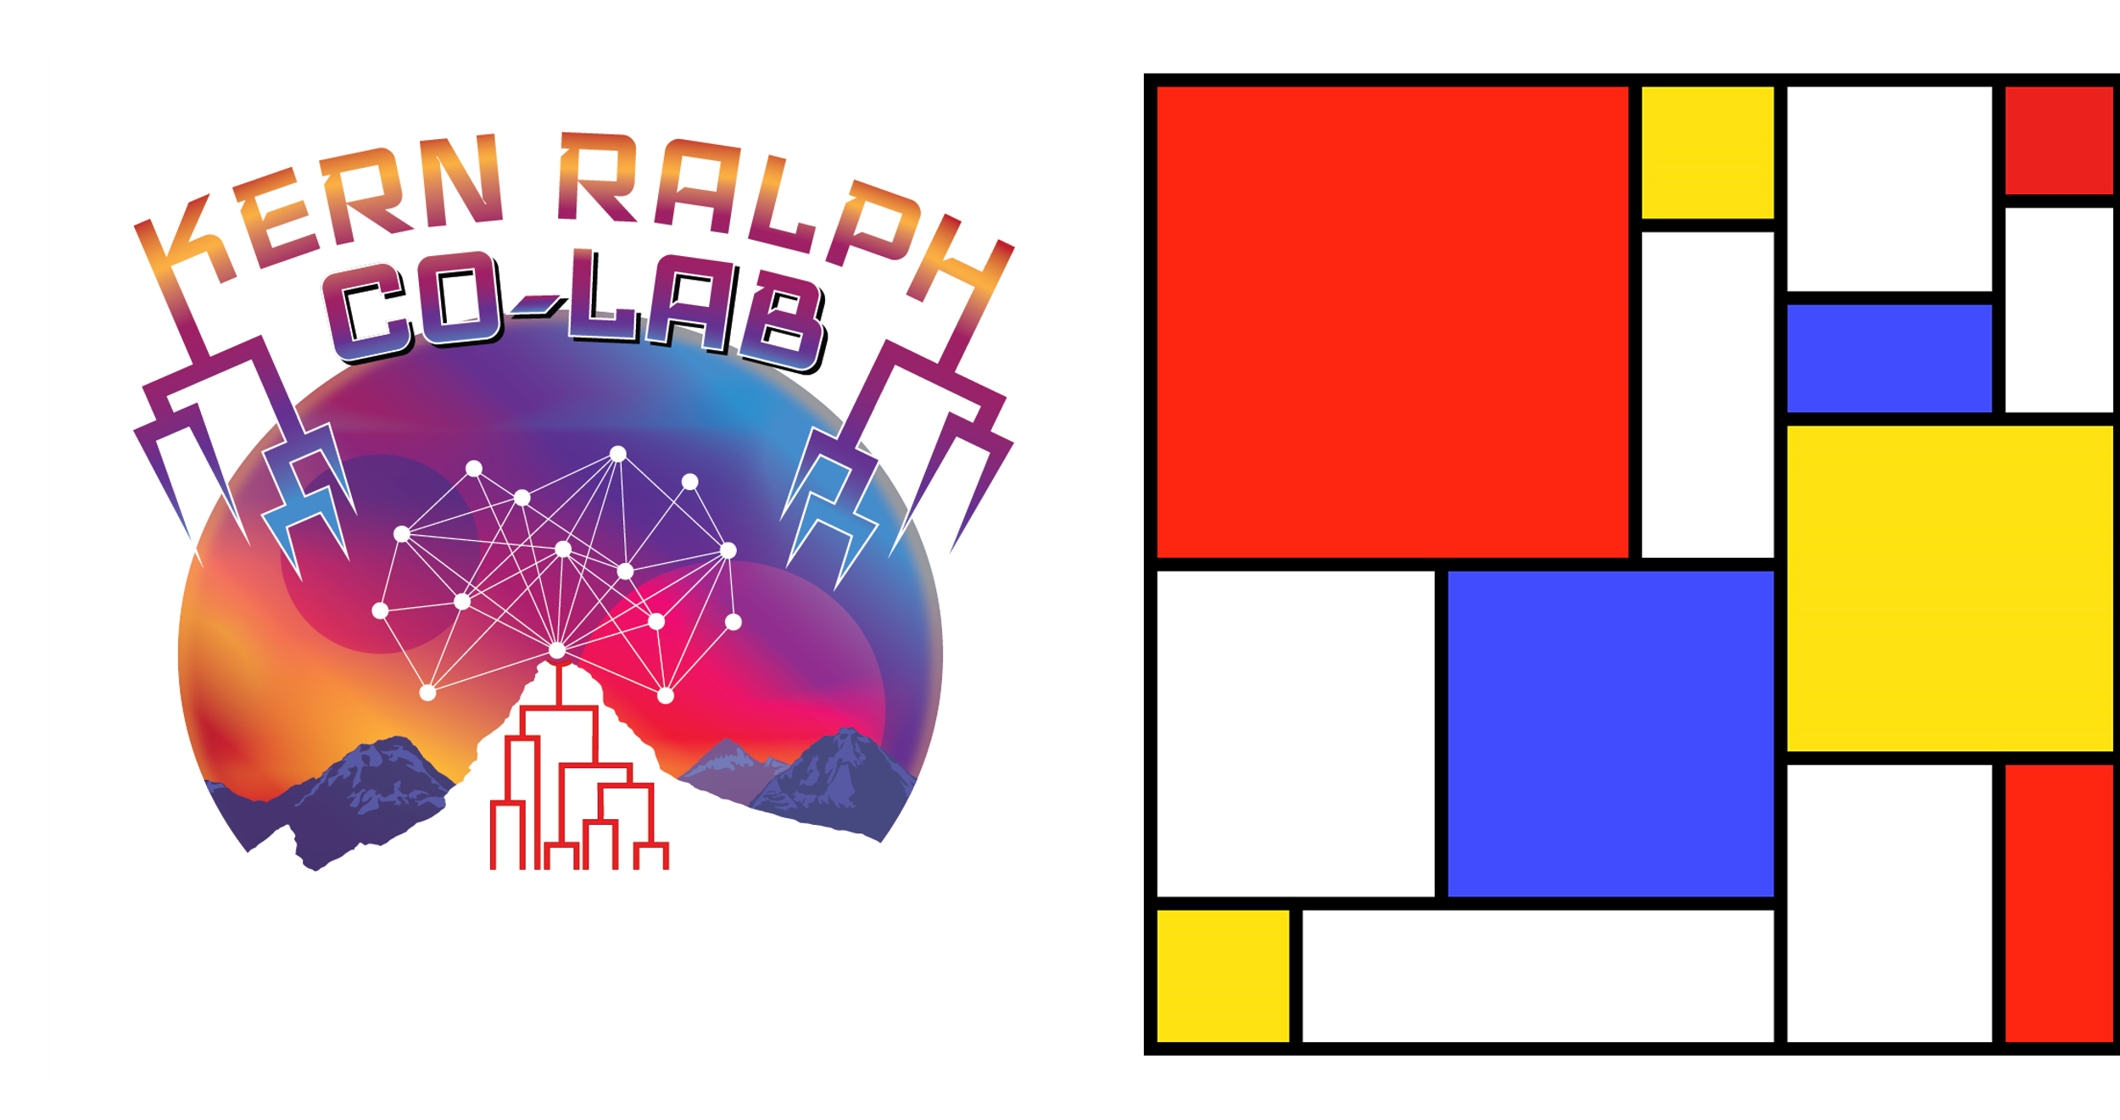

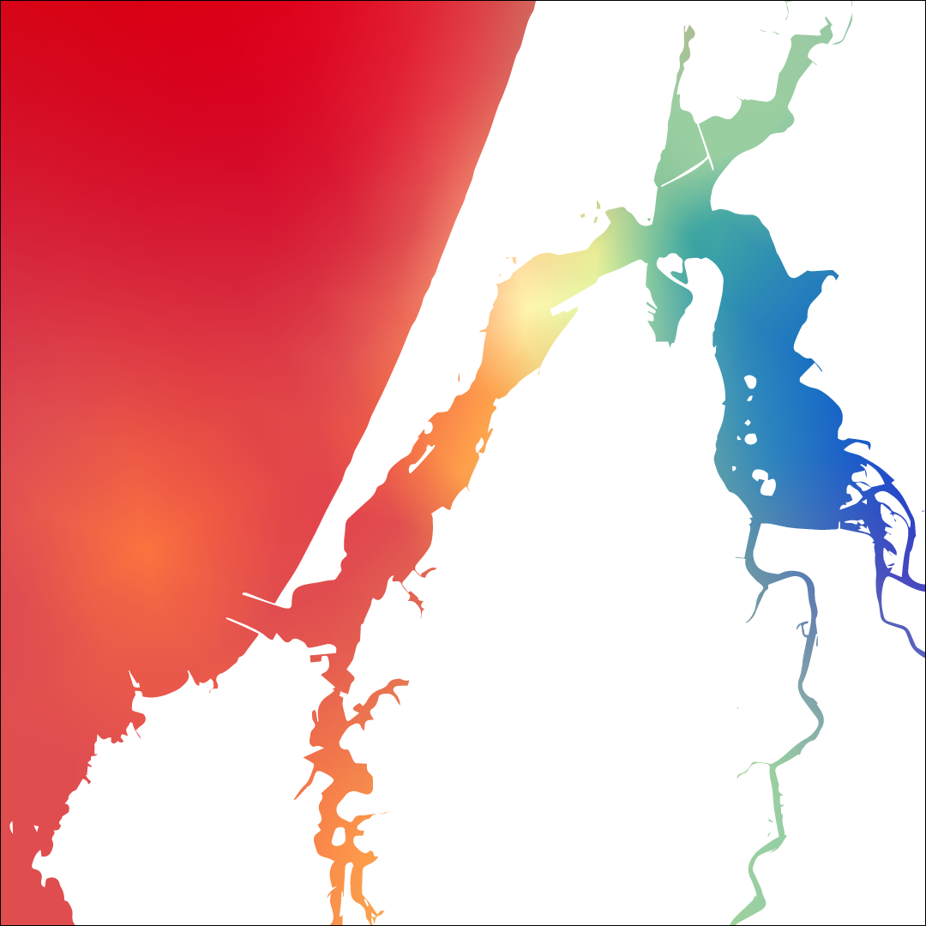
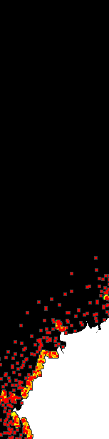
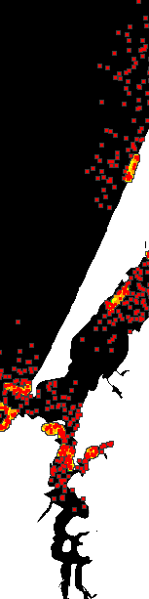

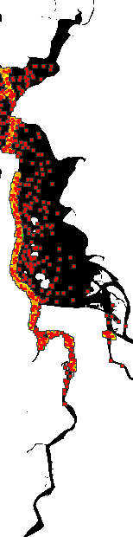
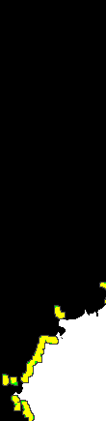
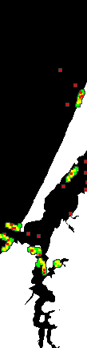
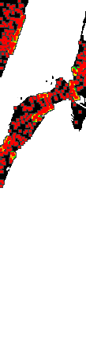
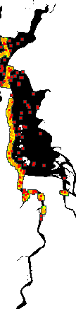
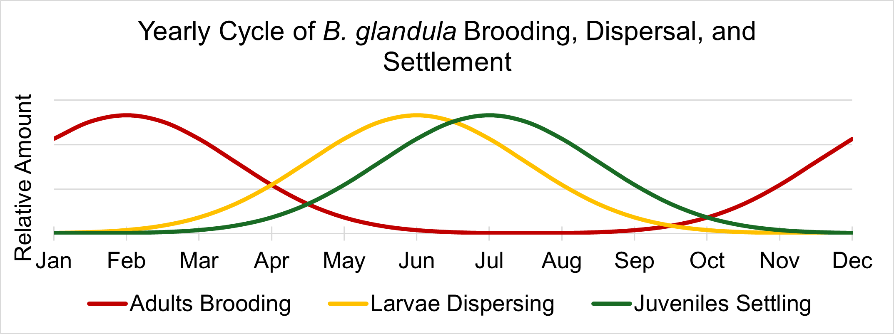
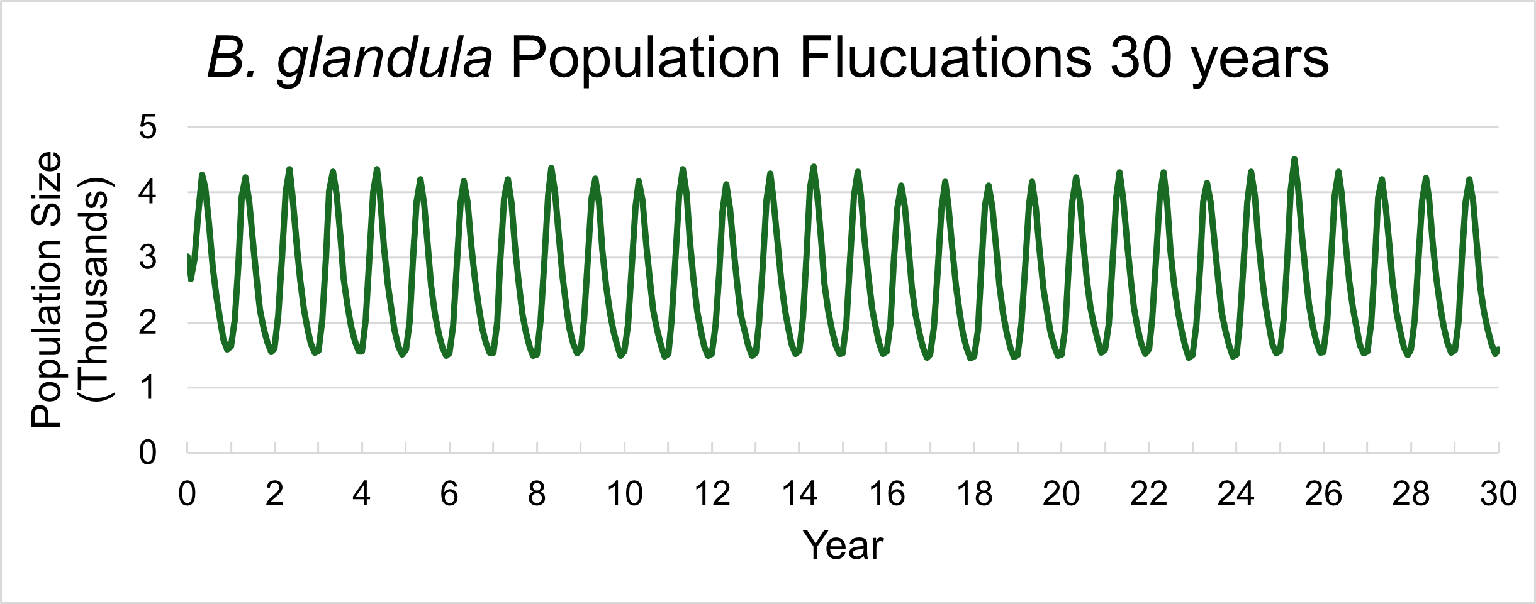
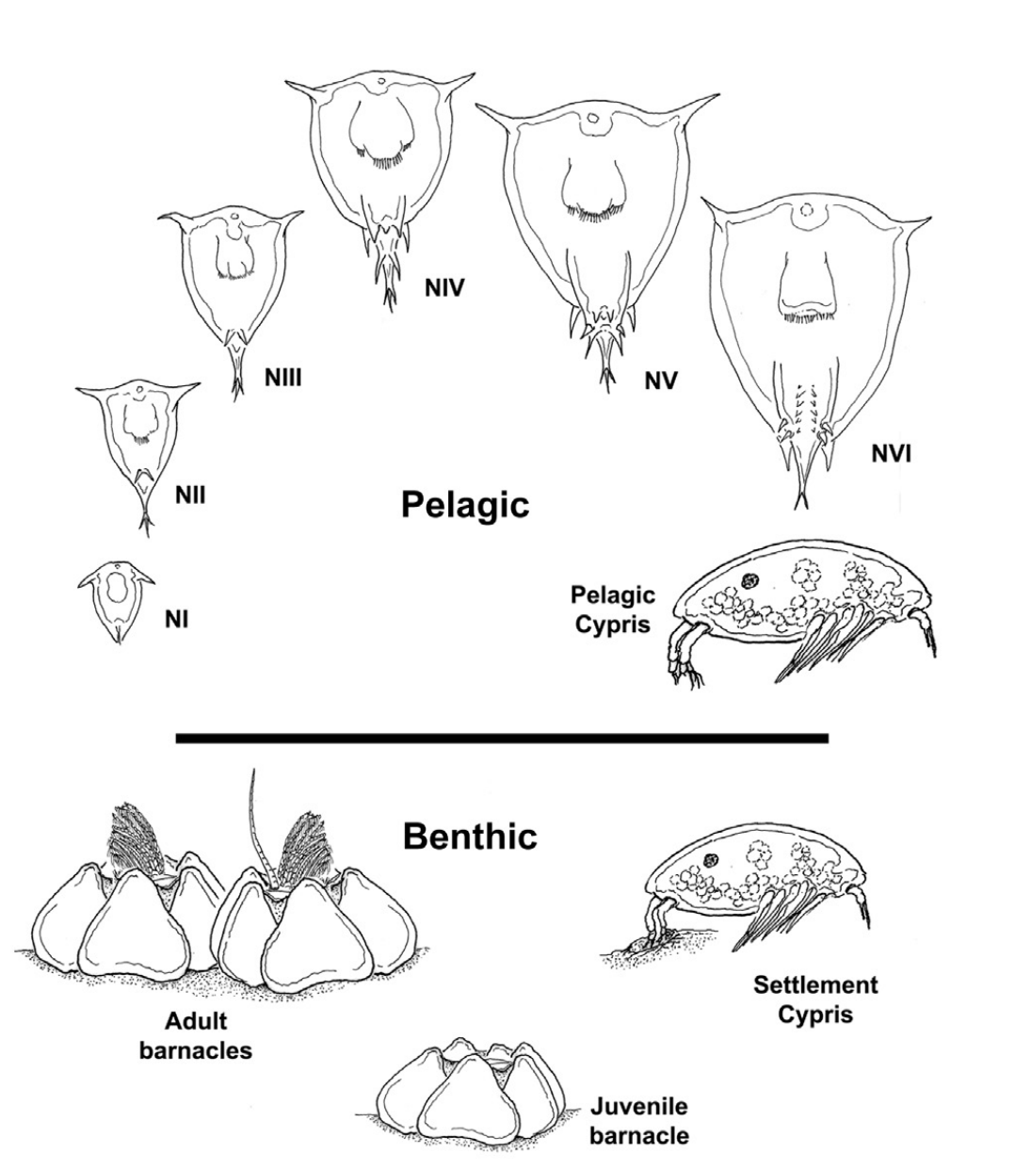
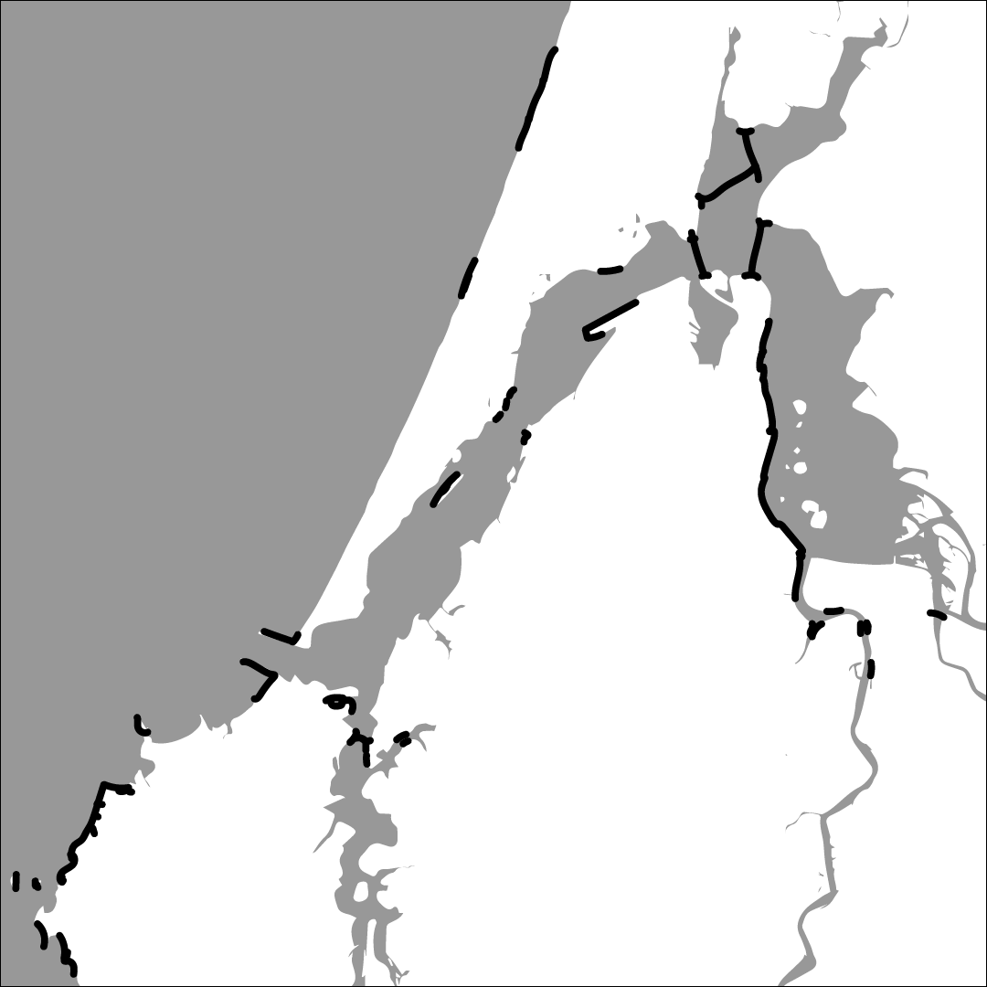
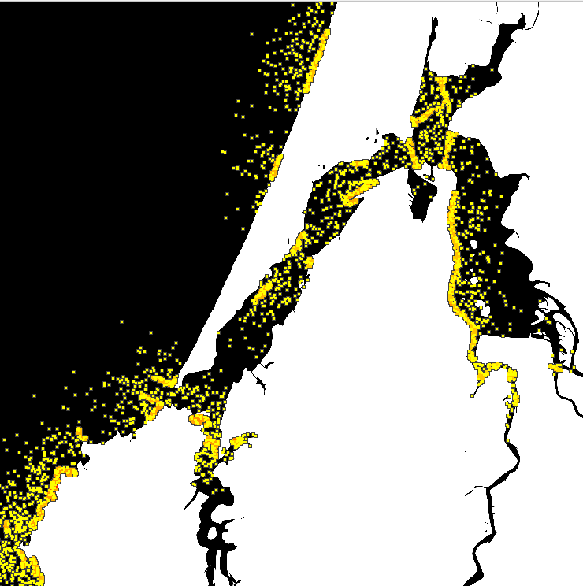
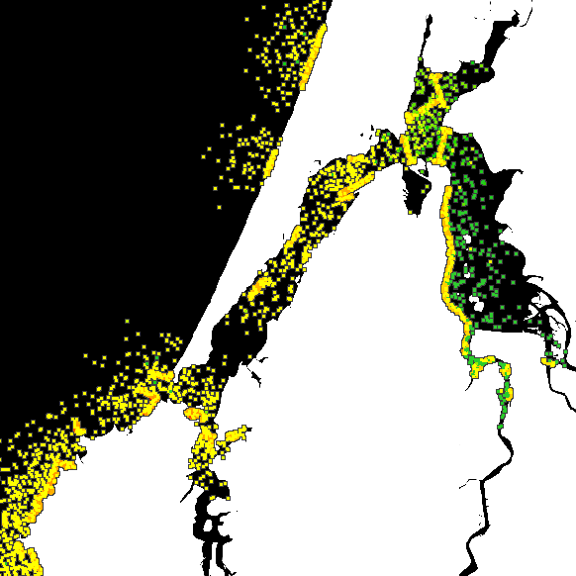
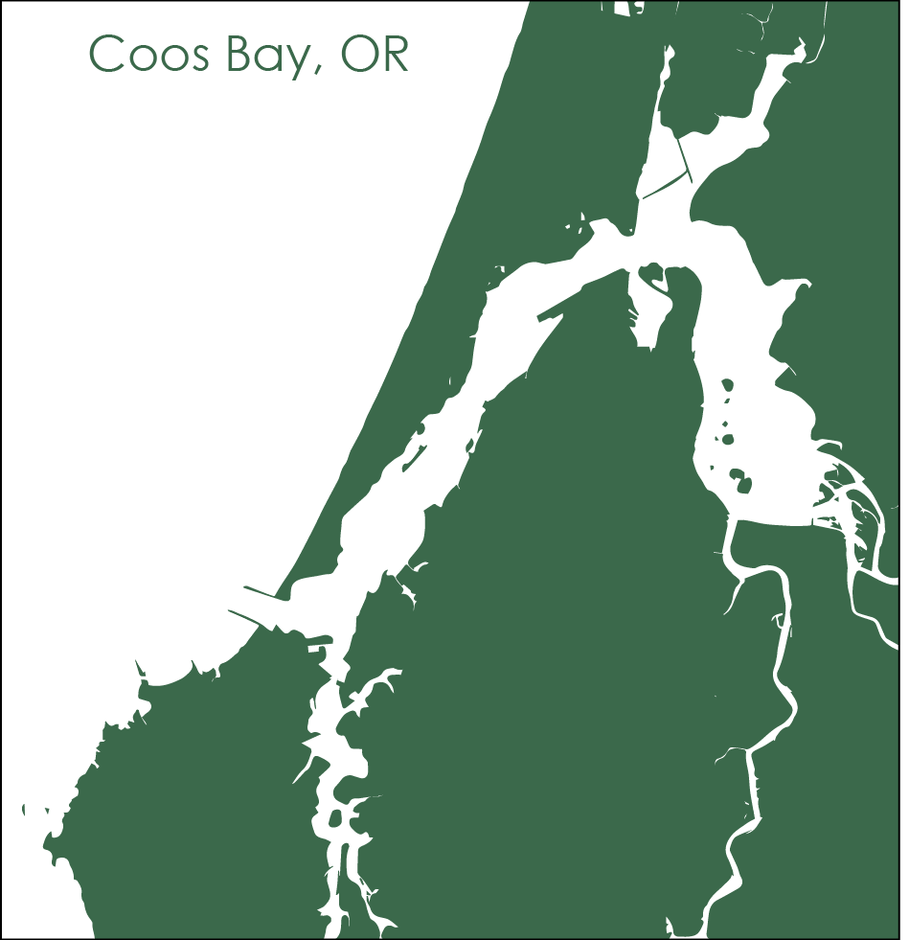
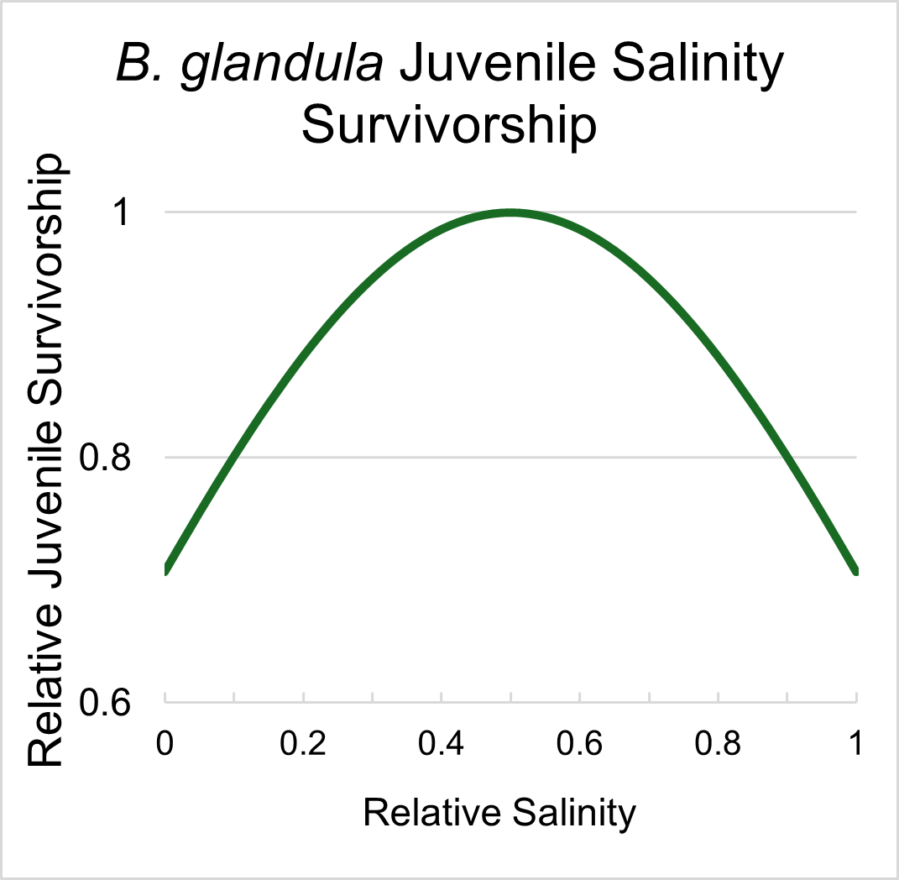
What a Load of Barnacles! A Spatial Genomic Simulation Measuring Evolution at Large Scales
Alex Bangs¹, Angel Rivera-Colón¹, Jiseon Min¹, Peter Ralph^{1,2}
¹ Institute of Ecology and Evolution, University of Oregon, Eugene, Oregon, USA, ² Department of Mathematics, University of Oregon, Eugene, Oregon, USA
[Abstract]
Simulating with SLiM
Results
Advances in computational biology have allowed evolutionary biologists to develop simulations that expand our understanding of population genetics across continuous space. However, quantifying evolution at scale continues to be constrained by available computational resources, and the modeling of spatial population genomics of large populations requires efficient use of processing power and accurate simulation parameters.
//1. Adults reproduce with nearest neighbor, if possible
mate = i2.drawByStrength(individual, 1);
AdjustedFecun = (Fecun + p1.spatialMapValue(“Salinity", pos));
PBrood = dnorm(Month, 7, 1.5) * (0.7/dnorm(7, 7, 1.5));
if ((mate.size() > 0) & (runif(1) < PBrood) & (nOff>0))
p1.addCrossed(individual, mate, count=rpois(1, AdjustedFecun));
Without Seasonal Reproduction
With Seasonal Reproduction
How can we efficiently model large-scale population genomics?
Jan
Apr
Jul
Oct
Jan
Apr
Jul
Oct
Larvae
Juveniles
Adults
Our Subject and Setting
//2. Move larvae and settle juveniles
pos = larvae.spatialPosition;
pos = Map1.sampleNearbyPoint(pos, 1.9,"n",0.975);
larvae.setSpatialPosition(pos);
pos = juveniles.spatialPosition;
pos = Map2.sampleNearbyPoint(pos, 1.9*3, "n", 0.975*3);
juveniles.setSpatialPosition(pos);
No Adaptation
Adaptation to Low Salinity
//3. Adjust juvenile fitness based on salinity
for (individual in juveniles){
pos = individual.spatialPosition;
salin_value = (p1.spatialMapValue("Salinity", pos)); individual.fitnessScaling = individual.fitnessScaling * (dnorm(salin_value, 0.5, 0.6)/dnorm(0.5, 0.5, 0.6)); }
//4. Scale the fitness of the individuals based on their location in the map
inds = sim.subpopulations.individuals;
phenotype_m1 = inds.sumOfMutationsOfType(m1); environment_m1 = Map4.mapValue(pos);
inds.fitnessScaling = inds.fitnessScaling * (1+dnorm(phenotype_m1, enviro_m1, environment_sd));
Low Fitness
Moderate Fitness
High Fitness
Acknowledgments
Thank you to Erin Jesuit of the VonDassow Lab at OIMB for your help collecting and analyzing B. glandula samples. To the entirety of the Kern Ralph Co-Lab for being a wonderful group to collaborate and research with. To Ben Haller and Philipp Messer for the development of SLiM: An Evolutionary Simulation Framework. And to the University of Oregon Summer Program for Undergraduate Research and the Mary G. Alden Fellowship for the opportunity to pursue summer research.
//5. Model density-dependent selection with spatial competition
i1.evaluate(p1);
competition = i1.localPopulationDensity(adults);
adult_local_l = p1.spatialMapValue(“Habitat", adults.spatialPosition);
adults.fitnessScaling = 1/(1 + (RHO * competition / adult_local_l));
References
Berger, M. S. (2009). Reproduction of the Intertidal Barnacle Balanus Glandula Along an Estuarine Gradient. Marine Ecology, 30(3), 346–353. https://doi.org/10.1111/j.1439-0485.2009.00280.x
Berger, M. S., Darrah, A. J., & Emlet, R. B. (2006). Spatial and temporal variability of early post-settlement survivorship and growth in the barnacle Balanus glandula along an estuarine gradient—ScienceDirect. Journal of Experimental Marine Biology and Ecology, 336(1), 74–87.
Conroy, T., Sutherland, D. A., & Ralston, D. K. (2020). Estuarine Exchange Flow Variability in a Seasonal, Segmented Estuary. Journal of Physical Oceanography, 50(3), 595-613, 50(3), 595–613.
Haller, B. C., & Messer, P. W. (2023). SLiM 4: Multispecies Eco-Evolutionary Modeling. The American Naturalist, 201(5), E127–E139. https://doi.org/10.1086/723601
Hiebert, T. C., & Jarvis, M. (2015). Balanus glandula. In Oregon Estuarine Invertebrates: Rudys’ Guide to Common Species (3rd ed., pp. 574–580). University of Oregon Libraries and Oregon Institute of Marine Biology.
Marin Jarrin, M. J., & Sutherland, D. A. (2022). Wind Effects on the Circulation of a Geometrically-Complex Small Estuary. Estuarine, Coastal and Shelf Science, 278, 108092. https://doi.org/10.1016/j.ecss.2022.108092
Matz, M. V., Treml, E. A., & Haller, B. C. (2020). Estimating the potential for coral adaptation to global warming across the Indo-West Pacific. Global Change Biology, 26(6), 3473–3481. https://doi.org/10.1111/gcb.15060
Suárez-Morales, E. (2015). Chapter 29—Class Maxillopoda. In J. H. Thorp & D. C. Rogers (Eds.), Thorp and Covich’s Freshwater Invertebrates (Fourth Edition) (pp. 709–755). Academic Press. https://doi.org/10.1016/B978-0-12-385026-3.00029-2
Notes:
Less Code
Center Important Question and Results
No need to separate Results and Methods if it flows better
More explanation of graphics

